Slide 1

ADAPTIVE WHEEL ALIGNMENT SYSTEM FOR VEHICLES
Group Suspenso
A.G.I. ISURANGA (E/20/154)
C.M.KEERTHISENA (E/20/198)
A.P. THILAKARATHNE (E/20/395)
E.M.I.U. WIJERATHNA (E/20/443)
Supervised by Dr D.H.S Maithripala
Department of Mechanical Engineering
Faculty of Engineering
University of Peradeniya
ME325- Mechanical Engineering Group Project
Proposal Presentation
May, 2025

Slide 2
Aim and Objective of the project
Aim
To create an adaptive wheel alignment system based on machine learning that changes the vehicle's wheel camber and toe angles in real time to enhance performance, safety, and stability while driving.
Objectives
To study the effect of camber and toe angles on vehicle stability and handling using simulations.
Design a simulation-driven model for dynamic wheel alignment.
Integrate machine learning to predict optimal camber/toe angles.
Validate system performance across diverse driving conditions.
improve cornering grip, and vehicle stability.

Slide 3

INTENDED LEARNING OUTCOMES
Technical proficiency in MATLAB Simulink, Carsim and ML algorithms.
Problem-solving skills in real-time vehicle dynamics.
Team collaboration and project management.
Learn project management skills, including task allocation and meeting deadlines.
Improve critical thinking through data analysis and system evaluation.
Critical analysis of simulation results.

Slide 4
INTRODUCTION
Problem
Passive alignment systems do not adapt well to dynamic driving conditions such as cornering or uneven roads. Meanwhile, existing dynamic systems are often not cost-effective and are not widely accessible for academic use.
Solution
Develop an ML-based system that adjusts camber/toe angles in real-time using sensor data (speed, steering input,road conditions).
Scope
Enhance vehicle stability across varying road conditions using real-time sensor data within a simulation environment. Develop, simulate, and validate a fully dynamic adaptive alignment system with potential for future hardware integration.

Slide 5
Methodology
Design Phase
In the design phase, we simulate vehicle behavior using simulators(CarSim and Simulink) for different road conditions(wet,dry). Sensor (Steering angle,speed,incline) are used to train a machine learning model that predicts the best camber and toe angles in real time. This adaptive system adjusts to real driving situations, unlike fixed or rule-based setups, and works for both high-end and low-end vehicles
Implementing Phase
A machine learning model will be trained on this data and integrated into simulation(CarSim and Simulink) to predict alignment angles in real time. The model will be tested in closed-loop simulations to adjust camber and toe dynamically and evaluate its impact on vehicle stability.
Testing Phase
Test above implemented system for improve below conditions, ● Accuracy of the ML model in predicting optimal alignment angles ● Consistency of model output across repeated runs ● Stability improvement through real-time control
Evaluating Phase The system’s effectiveness will be evaluated by comparing simulation results from differnt tools like CarMaker and VI-CarRealTime, as well as against known theoretical benchmarks. This ensures unbiased validation across platforms.

Slide 6



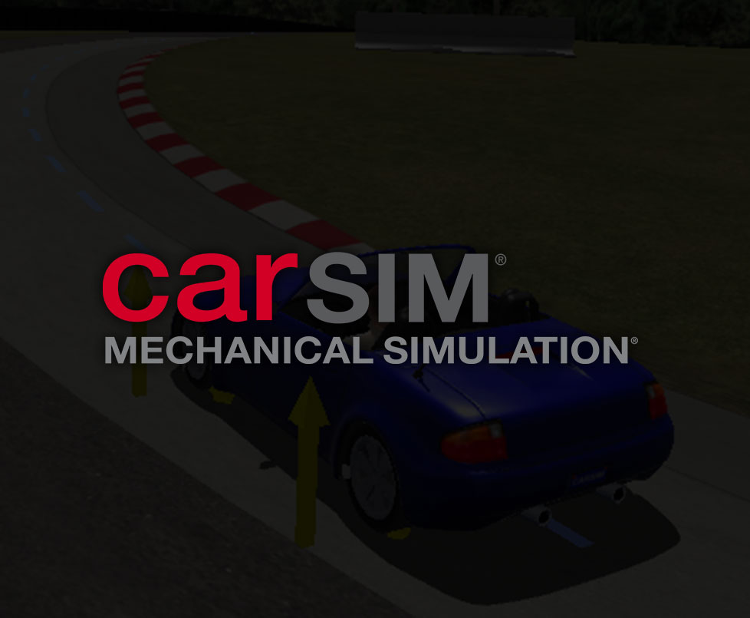
PROPOSED SOFTWARE
Matlab Simulink
CarSim
IPG CarMaker
VI-CarRealtime

Slide 7
TIMELINE
 | Task Description | Week
 |  | 1 | 2 | 3 | 4 | 5 | 6 | 7 | 8 | 9 | 10 | 11 | 12 | 13 | 14
1. | Selecting a Project Title
2. | Literature Review and Background Study
3. | Project Proposal Development & Presentation
4. | Learning Simulation Software
5. | Learning Machine Learning
6. | Gathering Datasets from Simulation
7. | Design & Development of Machine Learning Model
9. | Mid-evaluation Presentation
10. | Training the Machine Learning Model
11. | Testing and Validation
12. | Drafting Reports and Final Presentation
13. | Final Demonstration

Slide 8
REFERENCES
[1] Kavitha, C., Shankar, S.A., Karthika, K., Ashok, B. and Ashok, S.D. (2019). Active camber and toe control strategy for the double wishbone suspension system. Journal of King Saud University - Engineering Sciences, [online] Available at: https://www.sciencedirect.com/science/article/pii/S1018363917302799 [2] Yu, M., Evangelou, S. and Dini, D. (2023). Advances in Active Suspension Systems for Road Vehicles. Engineering, [online] Available at: https://www.sciencedirect.com/science/article/pii/S2095809923003983
[3] Balázs Németh and Péter Gáspár (2015). LPV-based Variable-Geometry Suspension Control [online] Available at: https://www.sciencedirect.com/science/article/pii/S2405896315023721

Slide 9


Slide 10
THANK YOU

